Slide 1
Slicer’s Coordinate Systems
Chand T. John
Neuromuscular Biomechanics Lab
Stanford University

Slide 2
What is a Coordinate System?
v₃
A coordinate system for a three-dimensional space is a point O called the origin along with three linearly independent vectors v₁, v₂, and v₃.
Linearly independent here means no two of the vectors are parallel and the three vectors do not all lie in the same plane.
O
v₁
v₂

Slide 3
The RAS Coordinate System
Every scanned object has its own fixed
coordinate system known as the RAS
coordinate system. “RAS” stands for Right,
Anterior, Superior. For CT and MRI
machines, the RAS coordinate system is fixed
with respect to the scan table and the object or
subject being scanned (the “scanee” if you wish).

Slide 4
The RAS Coordinate System
Superior
S
A
Anterior
R
Left
Right
Posterior
Inferior

Slide 5
The Three Viewing Directions
Coronal
Sagittal
S
S
S
R
L
A
P
A
I
I
L
R
P
I
Axial
Axial
A
Sagittal
R
L
Coronal
P

Slide 6
Medical Image Scan Directions
A medical scanner acquires data by scanning individual 2D slices along an axis:
Axial: SI
Axial: IS
Sagittal: RL
Sagittal: LR
Coronal: AP
Coronal: PA
S
A
L
R
P
I

Slide 7
The IJK Coordinate System
Every medical scanner has its own coordinate
system called the IJK coordinate system. The
IJK coordinate system represents the actual
rectangular prism of data that is scanned,
instead of the position of the scan table (the
coordinate system of the “scanner”).

Slide 8
The IJK Coordinate System
k
j
-i
i
-j
-k

Slide 9
Coordinate System Conversion
We frequently need to convert between
coordinate systems, such as RAS and IJK.
The mapping from one coordinate system to
another is a 3D affine transformation: a
sequence of transformations consisting of a
shear, a reflection, a rotation, a scaling, and a
translation.

Slide 10
Affine Transformations
An affine transformation is simply a matrix multiplication applied to a point followed by a translation. Any affine transformation can be decomposed as follows:
x’
y’
z’
x
y
z
Reflection,
Rotation
=
Scaling
Shear
+
Translation

Slide 11
Affine Transformations
Z
Y
X
Let us examine how an affine transformation works within the standard coordinate system in 3D: this is the coordinate system with its origin at the point (0, 0, 0) and the three basis vectors (1, 0, 0), (0, 1, 0), and (0, 0, 1). We conventionally call label the axes representing these basis vectors as the X, Y, and Z axes.

Slide 12
Shear
A shear transformation consists of shearing in each of the three coordinate planes: the XY, XZ, and YZ planes.
A shear in the XY plane translates every plane parallel to the XY plane by an amount in x and y proportional to the z value of that plane.
Thus z = 0 plane does not move at all

Slide 13
Shear
Shearing in the XY plane:
x’ = x + f_{x}z
y’ = y + f_{y}z
z’ = z
x’
y’
z’
1 0 f_{x}
0 1 f_{y}
0 0 1
x
y
z
=
Shearing in the XZ plane:
x’ = x + g_{x}y
y’ = y
z’ = z + g_{z}y
x’
y’
z’
1 g_{x} 0
0 1 0
0 g_{z} 1
x
y
z
=
Shearing in the YZ plane:
x’ = x
y’ = y + h_{y}x
z’ = z + h_{z}x
x’
y’
z’
1 0 0
h_{y} 1 0
h_{z} 0 1
x
y
z
=

Slide 14
Reflection
Reflection about the XY plane is a simple transformation: simply negate the Z coordinate.
Z
x’
y’
z’
1 0 0
0 1 0
0 0 -1
x
y
z
=

Slide 15
Reflection
The reflection about the XY plane is the only reflection needed to generate any affine transformation, since a reflection about any other plane can be performed by conjugating the reflection about the XY plane with a translation and a rotation (and rotations and translations are already used in affine transformations):
Rotation, then translation of XY plane to target plane
Translation, then rotation of target plane to XY plane
Reflection about target plane
Reflection about XY plane
=

Slide 16
Rotation
Every rotation in 3D is a combination of rotations around each of the standard coordinate axes.
Z
γ
β
α
Y
X

Slide 17
Rotation
Rotation around the X axis:
x’
y’
z’
1 0 0
0 cos γ -sin γ
0 sin γ cos γ
x
y
z
=
Rotation around the Y axis:
x’
y’
z’
cos β 0 sin β
0 1 0
-sin β 0 cos β
x
y
z
=
Rotation around the Z axis:
x’
y’
z’
cos α -sin α 0
sin α cos α 0
0 0 1
x
y
z
=

Slide 18
Scaling
Scaling, also known as dilation, simply stretches the 3D space in each of the three standard coordinate directions X, Y, and Z by factors of S_{x}, S_{y}, and S_{z} respectively.
If S_{x} = S_{y} = S_{z}, then the scaling is said to be isotropic. Otherwise, the scaling is anisotropic.
x’
y’
z’
s_{x} 0 0
0 s_{y} 0
0 0 s_{z}
x
y
z
=

Slide 19
Translation
Translation is a very simple operation: it simply slides every point in space by a fixed vector (t_{x}, t_{y}, t_{z}):
x’
y’
z’
x
y
z
t_{x}
t_{y}
t_{z}
=
+

Slide 20
Affine Transformations
We can see that all of the components of an affine transformation are either a multiplication by a 3 x 3 matrix or an addition of a 3 x 1 matrix. In fact, all transformations consisting of such a matrix multiplication followed by such a translation are affine transformations.
x’
y’
z’
a₁₁ a₁₂ a₁₃
a₂₁ a₂₂ a₂₃
a₃₁ a₃₂ a₃₃
x
y
z
t_{x}
t_{y}
t_{z}
=
+

Slide 21
Homogeneous Coordinates
When using homogeneous coordinates, we assign an extra coordinate of “1” to all points and an extra coordinate of “0” to all vectors:
3
2
6
1
4
7
3
0
Point
3
2
6
Vector
4
7
3
Using homogeneous coordinates, affine maps are written with a single matrix:
x’
y’
z’
1
a₁₁ a₁₂ a₁₃ t_{x}
a₂₁ a₂₂ a₂₃ t_{y}
a₃₁ a₃₂ a₃₃ t_{z}
0 0 0 1
x
y
z
1
=

Slide 22
Affine Transformation Summary
Any time you need to map one coordinate system to another, you are using an affine transformation.
Affine transformations are represented in Slicer using homogeneous coordinates, as 4 x 4 matrices.
Every affine transformation consists of some, if not all, of the components listed in the arrow below, applied in that order.
v₁’
v₃
Shear, reflection, rotation,
scaling, translation
v₂
O’
O
v₃’
v₁
v₂’

Slide 23
The IJK Coordinate Systems
For each scan order (LR, RL, AP, PA, IS, SI),
there is a unique IJK coordinate system
associated with it. In Slicer, the resulting
transformation from the RAS coordinate
system to the IJK coordinate system is an
affine transformation consisting of a possible
reflection, a rotation by a multiple of 90º in zero
or more directions, a scaling, and a translation.

Slide 24
The IJK Coordinate Systems
k
j
j
Axial: IS
Sagittal: LR
Coronal: PA
j
-i
k
i
-i
-k
k
i
-i
-j
i
-k
-k
-j
-j
-k
j
j
Axial: SI
Sagittal: RL
-i
Coronal: AP
-k
j
i
-i
k
-k
i
-i
k
-j
i
k
-j
-j

Slide 25
RAS to IJK Transformation
So the RAS to IJK transformation typically contains a possible reflection, a rotation by a multiple of 90º in zero or more directions, a scaling, and a translation.
If a CT scanner’s scan table was tilted in one or more directions to limit radiation delivered to a patient’s vital organs, the RAS to IJK transformation will also contain an arbitrary rotation, not necessarily by a multiple of 90º. This scan table tilting is known as gantry tilt.
Sometimes the desired anatomy is imaged in an oblique direction to improve accuracy. This oblique acquisition will result in the RAS to IJK transformation containing a shear.
Thus, an arbitrary RAS-to-IJK transformation can contain all the components of an arbitrary affine transformation!
An RAS-to-IJK transformation should always be invertible: inverting the RAS-to-IJK 4 x 4 matrix yields the IJK-to-RAS matrix.

Slide 26
RAS to IJK Transformation
Fortunately, the RAS-to-IJK transformation for every data set loaded into Slicer is
stored in Slicer. To obtain the 4 x 4 transformation matrix:
  Find the ID number of the data volume whose RAS-to-IJK transformation you want to obtain: go to the Editor→Volumes and select the original grayscale to be volume you want. Then in the Tcl/Tk window, type puts [EditorGetOriginalID] and press Enter. The ID number of the volume you wanted is the output. We’ll pretend the ID number is 1.
  In the Tcl/Tk window, type the following commands:
  vtkMatrix4x4 mtx
  mtx DeepCopy [Volume(1,node) GetRasToIjk]
  Now mtx is a copy of the RAS-to-IJK matrix of the volume.
  To invert the matrix, type mtx Invert. mtx is now a copy of the IJK-to-RAS matrix for the volume.
  To apply mtx to the point 44 36 127 for example, simply type:
  mtx MultiplyPoint 44 36 127 1
  To print out the contents of mtx, type (without pressing Enter in between lines):
  for {set i 0} {$i < 4} {incr i} {
  for {set j 0} {$j < 4} {incr j} {
  puts [mtx GetElement $i $j]
  }
  }

Slide 27
The XYS Coordinate System
In Slicer, the axial, sagittal, and coronal views each have their own XYS coordinate system.
In each window, each voxel on each image slice has its own (X, Y) screen coordinates and the slice number in which it lies.
Slice S
Pixel (X, Y)

Slide 28
XYS to IJK Transformation
For the slice direction the user chose to segment in, we must first figure out how the XYS coordinates of any voxel map to the actual IJK coordinates of that voxel.
A clarification: the I coordinate labels the horizontal position of a voxel (ranges usually from 0 to 255, or 0 to 511). The J coordinate labels the vertical position of a voxel, and typically has the same range as the I coordinate. The K coordinate varies with the slice number in which a voxel lies.
Another clarification: for some reason, Slicer is designed so that in the axial and sagittal views, the slice number increases in the direction away from the viewer, while in the coronal view, the slice number increases in the direction toward the viewer. This is why the XYS axes are positioned differently for the coronal view when compared with the axial and sagittal views. The XYS axes also vary with scan order.
The XYS and IJK coordinate systems have their origins and whole numbered coordinates at the corners of voxels. The middle of a voxel will have non-integer coordinates that are multiples of ½.
In the following slides, the k=0 or k=n labels next to the IJK origin indicate whether the IJK origin is on slice 0, or on slice n, where n is the number of slices in the image data.

Slide 29
Inaccuracies
There are some inaccuracies in my
explanations of XYS to IJK transformations.
The IJK to RAS transformations are likely to
be accurate. Thus the XYS to RAS
transformations are also inaccurate. However,
the Slicer code for transforming between
coordinate systems is accurate.

Slide 30
Axial: IS IJK Coordinate System
Coronal
y
y
Sagittal
k
k
s
i
x
k
j
x
-j
j
s
k
i
i
-i
i = x
j = s
k = y
k
k = 0
i = -s
j = -x
k = y
-j
i
j
i
-k
j
S
Axial
A
y
j
j
L
R
i
s
k
x
i
-k
P
i = x
j = y
k = s
I

Slide 31
Axial: SI IJK Coordinate System
Coronal
y
y
Sagittal
-k
-k
s
i
x
-k
j
x
-j
j
s
i
i
-i
i = x
j = s
k = -y
j
k = n
i
i
i = -s
j = -x
k = -y
-j
j
k
k
k
S
Axial
j
A
y
j
L
R
i
s
i
x
k
k
P
i = x
j = y
k = -s
I

Slide 32
Sagittal: LR IJK Coordinate System
Coronal
y
y
Sagittal
j
j
s
-k
x
j
-i
x
i
-i
s
j
-k
k
j
-k
k = 0
i = -s
j = y
k = -x
k
i
i = x
j = y
k = s
i
k
i
-j
S
Axial
j
A
y
k
-i
L
R
-k
s
x
i
-j
P
i = -y
j = s
k = -x
I

Slide 33
Sagittal: RL IJK Coordinate System
Coronal
y
y
Sagittal
j
j
s
k
x
j
-i
x
i
-i
s
j
k
-k
k
k = n
i = -s
j = y
k = x
j
i = x
j = y
k = -s
i
i
i
k
k
-j
S
j
Axial
A
y
k
-i
L
R
k
s
x
i
-j
P
i = -y
j = s
k = x
I

Slide 34
Coronal: PA IJK Coordinate System
Coronal
y
y
Sagittal
j
j
s
i
x
j
k
x
-k
k
s
j
i
i
-i
i = x
j = y
k = s
j
k = 0
i = -s
j = y
k = -x
-k
i
k
i
-j
k
S
Axial
A
y
k
k
L
R
i
s
j
x
i
-j
P
i = x
j = s
k = y
I

Slide 35
Coronal: AP IJK Coordinate System
Coronal
y
y
Sagittal
j
j
s
i
x
j
-k
x
k
-k
s
j
i
i
-i
i = x
j = y
k = -s
k = n
j
k
i = -s
j = y
k = x
k
k
i
i
-j
S
Axial
j
A
y
i
-k
L
R
i
s
k
x
-j
P
i = x
j = s
k = -y
I

Slide 36
XYS to IJK Transformations
So, for Axial: IS images:
i
x
1 0 0
0 1 0
0 0 1
x
Axial XYS to IJK matrix is:
j
=
y
=
y
k
s
s
i
-s
0 0 -1
-1 0 0
0 1 0
x
Sagittal XYS to IJK matrix is:
j
=
-x
=
y
k
y
s
i
x
1 0 0
0 0 1
0 1 0
x
Coronal XYS to IJK matrix is:
j
=
s
=
y
k
y
s

Slide 37
XYS to IJK Transformations
For Axial: SI images:
i
x
1 0 0
0 1 0
0 0 -1
x
Axial XYS to IJK matrix is:
j
=
y
=
y
k
-s
s
i
-s
0 0 -1
-1 0 0
0 -1 0
x
Sagittal XYS to IJK matrix is:
j
=
-x
=
y
k
-y
s
i
x
1 0 0
0 0 1
0 -1 0
x
Coronal XYS to IJK matrix is:
j
=
s
=
y
k
-y
s

Slide 38
XYS to IJK Transformations
For Sagittal: LR images:
i
-y
0 -1 0
0 0 1
-1 0 0
x
Axial XYS to IJK matrix is:
j
=
s
=
y
k
-x
s
i
x
1 0 0
0 1 0
0 0 1
x
Sagittal XYS to IJK matrix is:
j
=
y
=
y
k
s
s
i
-s
0 0 -1
0 1 0 -1 0 0
x
Coronal XYS to IJK matrix is:
j
=
y
=
y
k
-x
s

Slide 39
XYS to IJK Transformations
For Sagittal: RL images:
i
-y
0 -1 0
0 0 1
1 0 0
x
Axial XYS to IJK matrix is:
j
=
s
=
y
k
x
s
i
x
1 0 0
0 1 0
0 0 -1
x
Sagittal XYS to IJK matrix is:
j
=
y
=
y
k
-s
s
i
-s
0 0 -1
0 1 0
1 0 0
x
Coronal XYS to IJK matrix is:
j
=
y
=
y
k
x
s

Slide 40
XYS to IJK Transformations
For Coronal: PA images
i
x
1 0 0
0 0 1
0 1 0
x
Axial XYS to IJK matrix is:
j
=
s
=
y
k
y
s
i
-s
0 0 -1
0 1 0
-1 0 0
x
Sagittal XYS to IJK matrix is:
j
=
y
=
y
k
-x
s
i
x
1 0 0
0 1 0
0 0 1
x
Coronal XYS to IJK matrix is:
j
=
y
=
y
k
s
s

Slide 41
XYS to IJK Transformations
For Coronal: AP images
i
x
1 0 0
0 0 1
0 -1 0
x
Axial XYS to IJK matrix is:
j
=
s
=
y
k
-y
s
i
-s
0 0 -1
0 1 0
1 0 0
x
Sagittal XYS to IJK matrix is:
j
=
y
=
y
k
x
s
i
x
1 0 0
0 1 0
0 0 -1
x
Coronal XYS to IJK matrix is:
j
=
y
=
y
k
-s
s

Slide 42
Medical Image Parameters
Scan order
Pixel spacing in horizontal direction (mm)
Pixel spacing in vertical direction (mm)
Slice thickness (mm)
Origin coordinates in RAS space
(mm, mm, mm)

Slide 43
Medical Image Parameters
Pixel spacing in horizontal direction (Δx)
Pixel spacing in vertical direction (Δy)
Slice thickness (Δz)
Origin coordinates in RAS space (O_{x}, O_{y}, O_{z})
Δz
2D Images
(O_{x}, O_{y}, O_{z})
Δy
Δx

Slide 44
Transformation Example
We will now demonstrate a detailed example of the possible XYS to IJK and IJK to RAS transformations that can occur.
This particular example has no gantry tilt or oblique acquisition: so the transformations here contain only reflection, rotation by multiples of 90º, scaling, and translation.

Slide 45
IJK to RAS Transformations
k
For Axial: IS images:
Axial: IS IJK
j
i
-i
R
-Δx * i + O_{x}
-Δx 0 0
0 Δy 0
0 0 Δz
i
O_{x}
A
=
Δy * j + O_{y}
=
j
+
O_{y}
-j
S
Δz * k + O_{z}
k
O_{z}
-k
Or in Slicer’s homogeneous coordinates:
S
RAS
A
R
-Δx 0 0 O_{x}
0 Δy 0 O_{y}
0 0 Δz O_{z}
0 0 0 1
i
A
=
j
L
R
S
k
(O_{x}, O_{y}, O_{z})
1
1
P
I
Note: the RasToIjk matrix in Slicer that we are using is that of the image, and not of the labelmap that represents the segmentation. We invert RasToIjk to get the IjkToRas matrix.

Slide 46
IJK to RAS Transformations
-k
For Axial: SI images:
Axial: SI IJK
j
i
-i
R
-Δx * i + O_{x}
-Δx 0 0
0 Δy 0
0 0 -Δz
i
O_{x}
A
=
Δy * j + O_{y}
=
j
+
O_{y}
-j
S
-Δz * k + O_{z}
k
O_{z}
k
Or in Slicer’s homogeneous coordinates:
S
RAS
A
R
-Δx 0 0 O_{x}
0 Δy 0 O_{y}
0 0 -Δz O_{z}
0 0 0 1
i
A
=
j
L
R
S
k
(O_{x}, O_{y}, O_{z})
1
1
P
I

Slide 47
IJK to RAS Transformations
j
For Sagittal: LR images:
Sagittal: LR IJK
-i
-k
k
R
Δz * k + O_{x}
0 0 Δz
-Δx 0 0
0 Δy 0
i
O_{x}
A
=
-Δx * i + O_{y}
=
j
+
O_{y}
i
S
Δy * j + O_{z}
k
O_{z}
-j
Or in Slicer’s homogeneous coordinates:
S
RAS
A
R
0 0 Δz O_{x}
-Δx 0 0 O_{y}
0 Δy 0 O_{z}
0 0 0 1
i
A
=
j
L
R
S
k
(O_{x}, O_{y}, O_{z})
1
1
P
I

Slide 48
IJK to RAS Transformations
j
For Sagittal: RL images:
Sagittal: RL IJK
-i
k
-k
R
-Δz * k + O_{x}
0 0 -Δz
-Δx 0 0
0 Δy 0
i
O_{x}
A
=
-Δx * i + O_{y}
=
j
+
O_{y}
i
S
Δy * j + O_{z}
k
O_{z}
-j
Or in Slicer’s homogeneous coordinates:
S
RAS
A
R
0 0 -Δz O_{x}
-Δx 0 0 O_{y}
0 Δy 0 O_{z}
0 0 0 1
i
A
=
j
L
R
S
k
(O_{x}, O_{y}, O_{z})
1
1
P
I

Slide 49
IJK to RAS Transformations
j
For Coronal: PA images:
Coronal: PA IJK
k
i
-i
R
-Δx * i + O_{x}
-Δx 0 0
0 0 Δz
0 Δy 0
i
O_{x}
A
=
Δz * k + O_{y}
=
j
+
O_{y}
-k
S
Δy * j + O_{z}
k
O_{z}
-j
Or in Slicer’s homogeneous coordinates:
S
RAS
A
R
-Δx 0 0 O_{x}
0 0 Δz O_{y}
0 Δy 0 O_{z}
0 0 0 1
i
A
=
j
L
R
S
k
(O_{x}, O_{y}, O_{z})
1
1
P
I

Slide 50
IJK to RAS Transformations
j
For Coronal: AP images:
Coronal: AP IJK
-k
i
-i
R
-Δx * i + O_{x}
-Δx 0 0
0 0 -Δz
0 Δy 0
i
O_{x}
A
=
-Δz * k + O_{y}
=
j
+
O_{y}
k
S
Δy * j + O_{z}
k
O_{z}
-j
Or in Slicer’s homogeneous coordinates:
S
RAS
A
R
-Δx 0 0 O_{x}
0 0 -Δz O_{y}
0 Δy 0 O_{z}
0 0 0 1
i
A
=
j
L
R
S
k
(O_{x}, O_{y}, O_{z})
1
1
P
I

Slide 51
XYS to IJK to RAS
Axial: IS
IJK to RAS
XYS to IJK
XYS to RAS
Axial XYS to RAS matrix is:
-Δx 0 0 O_{x}
0 Δy 0 O_{y}
0 0 Δz O_{z}
0 0 0 1
1 0 0 0
0 1 0 0
0 0 1 0
0 0 0 1
-Δx 0 0 O_{x}
0 Δy 0 O_{y}
0 0 Δz O_{z}
0 0 0 1
=
Sagittal XYS to RAS matrix is:
-Δx 0 0 O_{x}
0 Δy 0 O_{y}
0 0 Δz O_{z}
0 0 0 1
0 0 -1 0
-1 0 0 0
0 1 0 0
0 0 0 1
0 0 Δx O_{x}
-Δy 0 0 O_{y}
0 Δz 0 O_{z}
0 0 0 1
=
Coronal XYS to RAS matrix is:
-Δx 0 0 O_{x}
0 Δy 0 O_{y}
0 0 Δz O_{z}
0 0 0 1
1 0 0 0
0 0 1 0
0 1 0 0
0 0 0 1
-Δx 0 0 O_{x}
0 0 Δy O_{y}
0 Δz 0 O_{z}
0 0 0 1
=

Slide 52
XYS to IJK to RAS
Axial: SI
IJK to RAS
XYS to IJK
XYS to RAS
Axial XYS to RAS matrix is:
-Δx 0 0 O_{x}
0 Δy 0 O_{y}
0 0 -Δz O_{z}
0 0 0 1
1 0 0 0
0 1 0 0
0 0 -1 0
0 0 0 1
-Δx 0 0 O_{x}
0 Δy 0 O_{y}
0 0 Δz O_{z}
0 0 0 1
=
Sagittal XYS to RAS matrix is:
-Δx 0 0 O_{x}
0 Δy 0 O_{y}
0 0 -Δz O_{z}
0 0 0 1
0 0 -1 0
-1 0 0 0
0 -1 0 0
0 0 0 1
0 0 Δx O_{x}
-Δy 0 0 O_{y}
0 Δz 0 O_{z}
0 0 0 1
=
Coronal XYS to RAS matrix is:
-Δx 0 0 O_{x}
0 Δy 0 O_{y}
0 0 -Δz O_{z}
0 0 0 1
1 0 0 0
0 0 1 0
0 -1 0 0
0 0 0 1
-Δx 0 0 O_{x}
0 0 Δy O_{y}
0 Δz 0 O_{z}
0 0 0 1
=

Slide 53
XYS to IJK to RAS
Sagittal: LR
IJK to RAS
XYS to IJK
XYS to RAS
Axial XYS to RAS matrix is:
0 0 Δz O_{x}
-Δx 0 0 O_{y}
0 Δy 0 O_{z}
0 0 0 1
0 -1 0 0
0 0 1 0
-1 0 0 0
0 0 0 1
-Δz 0 0 O_{x}
0 Δx 0 O_{y}
0 0 Δy O_{z}
0 0 0 1
=
Sagittal XYS to RAS matrix is:
0 0 Δz O_{x}
-Δx 0 0 O_{y}
0 Δy 0 O_{z}
0 0 0 1
1 0 0 0
0 1 0 0
0 0 1 0
0 0 0 1
0 0 Δz O_{x}
-Δx 0 0 O_{y}
0 Δy 0 O_{z}
0 0 0 1
=
Coronal XYS to RAS matrix is:
0 0 Δz O_{x}
-Δx 0 0 O_{y}
0 Δy 0 O_{z}
0 0 0 1
0 0 -1 0
0 1 0 0
-1 0 0 0
0 0 0 1
-Δz 0 0 O_{x}
0 0 Δx O_{y}
0 Δy 0 O_{z}
0 0 0 1
=

Slide 54
XYS to IJK to RAS
Sagittal: RL
IJK to RAS
XYS to IJK
XYS to RAS
Axial XYS to RAS matrix is:
0 0 -Δz O_{x}
-Δx 0 0 O_{y}
0 Δy 0 O_{z}
0 0 0 1
0 -1 0 0
0 0 1 0
1 0 0 0
0 0 0 1
-Δz 0 0 O_{x}
0 Δx 0 O_{y}
0 0 Δy O_{z}
0 0 0 1
=
Sagittal XYS to RAS matrix is:
0 0 -Δz O_{x}
-Δx 0 0 O_{y}
0 Δy 0 O_{z}
0 0 0 1
1 0 0 0
0 1 0 0
0 0 -1 0
0 0 0 1
0 0 Δz O_{x}
-Δx 0 0 O_{y}
0 Δy 0 O_{z}
0 0 0 1
=
Coronal XYS to RAS matrix is:
0 0 -Δz O_{x}
-Δx 0 0 O_{y}
0 Δy 0 O_{z}
0 0 0 1
0 0 -1 0
0 1 0 0
1 0 0 0
0 0 0 1
-Δz 0 0 O_{x}
0 0 Δx O_{y}
0 Δy 0 O_{z}
0 0 0 1
=

Slide 55
XYS to IJK to RAS
Coronal: PA
IJK to RAS
XYS to IJK
XYS to RAS
Axial XYS to RAS matrix is:
-Δx 0 0 O_{x}
0 0 Δz O_{y}
0 Δy 0 O_{z}
0 0 0 1
1 0 0 0
0 0 1 0
0 1 0 0
0 0 0 1
-Δx 0 0 O_{x}
0 Δz 0 O_{y}
0 0 Δy O_{z}
0 0 0 1
=
Sagittal XYS to RAS matrix is:
-Δx 0 0 O_{x}
0 0 Δz O_{y}
0 Δy 0 O_{z}
0 0 0 1
0 0 -1 0
0 1 0 0
-1 0 0 0
0 0 0 1
0 0 Δx O_{x}
-Δz 0 0 O_{y}
0 Δy 0 O_{z}
0 0 0 1
=
Coronal XYS to RAS matrix is:
-Δx 0 0 O_{x}
0 0 Δz O_{y}
0 Δy 0 O_{z}
0 0 0 1
1 0 0 0
0 1 0 0
0 0 1 0
0 0 0 1
-Δx 0 0 O_{x}
0 0 Δz O_{y}
0 Δy 0 O_{z}
0 0 0 1
=

Slide 56
XYS to IJK to RAS
Coronal: AP
IJK to RAS
XYS to IJK
XYS to RAS
Axial XYS to RAS matrix is:
-Δx 0 0 O_{x}
0 0 -Δz O_{y}
0 Δy 0 O_{z}
0 0 0 1
1 0 0 0
0 0 1 0
0 -1 0 0
0 0 0 1
-Δx 0 0 O_{x}
0 Δz 0 O_{y}
0 0 Δy O_{z}
0 0 0 1
=
Sagittal XYS to RAS matrix is:
-Δx 0 0 O_{x}
0 0 -Δz O_{y}
0 Δy 0 O_{z}
0 0 0 1
0 0 -1 0
0 1 0 0
1 0 0 0
0 0 0 1
0 0 Δx O_{x}
-Δz 0 0 O_{y}
0 Δy 0 O_{z}
0 0 0 1
=
Coronal XYS to RAS matrix is:
-Δx 0 0 O_{x}
0 0 -Δz O_{y}
0 Δy 0 O_{z}
0 0 0 1
1 0 0 0
0 1 0 0
0 0 -1 0
0 0 0 1
-Δx 0 0 O_{x}
0 0 Δz O_{y}
0 Δy 0 O_{z}
0 0 0 1
=

Slide 57
Summary: XYS to RAS
Axial: IS and Axial: SI
Axial XYS to RAS matrix is:
-Δx 0 0 O_{x}
0 Δy 0 O_{y}
0 0 Δz O_{z}
0 0 0 1
Sagittal XYS to RAS matrix is:
0 0 Δx O_{x}
-Δy 0 0 O_{y}
0 Δz 0 O_{z}
0 0 0 1
-Δx 0 0 O_{x}
0 0 Δy O_{y}
0 Δz 0 O_{z}
0 0 0 1
Coronal XYS to RAS matrix is:

Slide 58
Summary: XYS to RAS
Sagittal: LR and Sagittal: RL
Axial XYS to RAS matrix is:
-Δz 0 0 O_{x}
0 Δx 0 O_{y}
0 0 Δy O_{z}
0 0 0 1
Sagittal XYS to RAS matrix is:
0 0 Δz O_{x}
-Δx 0 0 O_{y}
0 Δy 0 O_{z}
0 0 0 1
-Δz 0 0 O_{x}
0 0 Δx O_{y}
0 Δy 0 O_{z}
0 0 0 1
Coronal XYS to RAS matrix is:

Slide 59
Summary: XYS to RAS
Coronal: PA and Coronal: AP
Axial XYS to RAS matrix is:
-Δx 0 0 O_{x}
0 Δz 0 O_{y}
0 0 Δy O_{z}
0 0 0 1
Sagittal XYS to RAS matrix is:
0 0 Δx O_{x}
-Δz 0 0 O_{y}
0 Δy 0 O_{z}
0 0 0 1
-Δx 0 0 O_{x}
0 0 Δz O_{y}
0 Δy 0 O_{z}
0 0 0 1
Coronal XYS to RAS matrix is:

Slide 60
XYS to RAS in Slicer
Because of the complexity of transforming XYS points to RAS, Slicer provides convenience routines for converting from XYS to RAS in real-time: meaning, it will only convert points that are currently lying on a visible slice in either the axial, sagittal, or coronal view windows.
The following C++ code segment converts a point screenPt containing just X and Y screen coordinates to an RAS point rasPt. The slice window containing screenPt is determined using the GetActiveSlice method. This code is valid only in the files vtkMrmlSlicer.h and vtkMrmlSlicer.cxx:
int screenPt[2];
screenPt[0] = 36;
screenPt[1] = 44;
int as = this->GetActiveSlice();
vtkFloatingPointType rasPt[3];
this->SetReformatPoint(as, screenPt[0], screenPt[1]);
this->GetWldPoint(rasPt);
// Now rasPt contains the RAS coordinates of the XYS
// point screenPt

Slide 61
XYS to RAS in Slicer
In any Tcl file, the following code will convert a screen point (x, y) in the active 2D window to an RAS point (xwld, ywld, zwld):
set s $Interactor(s) # gets active slice window
Slicer SetReformatPoint $s $x $y
scan [Slicer GetWldPoint] “%g %g %g” xwld ywld zwld
For converting from (x, y) to an IJK point (xijk, yijk, zijk) in Tcl:
set s $Interactor(s) # gets active slice window
Slicer SetReformatPoint $s $x $y
scan [Slicer GetIjkPoint] “%g %g %g” xijk yijk zijk
set xijk [expr int($xijk)]
set yijk [expr int($yijk)]
set zijk [expr int($zijk)]

Slide 62
Position Matrix
Just like GetRasToIjk retrieves a 4 x 4 RAS-to-IJK matrix for a volume, GetPosition retrieves a 4 x 4 matrix representing the position of the RAS coordinate system relative to the IJK coordinate system.
My conjecture is that the position matrix contains only the rigid transformation (reflection, rotation, translation) of the RasToIjk matrix. More precisely, in an experiment I found that:
IjkToRas = (Translate) * (Rotate/reflect) * (Scale)
Position = (Translate) * (Rotate/reflect)

Slide 63
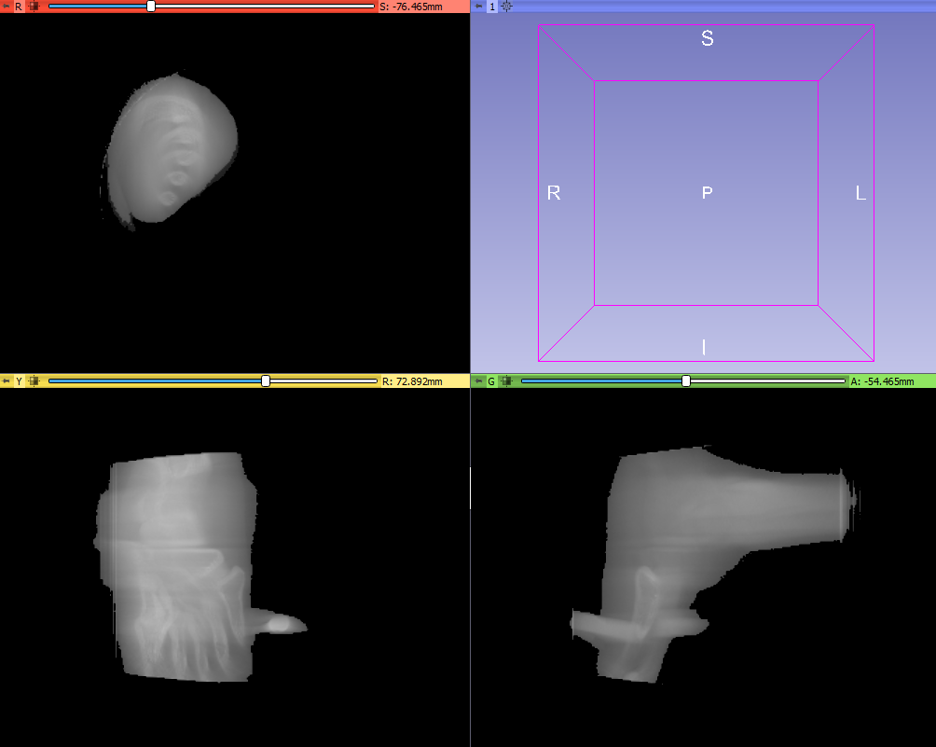
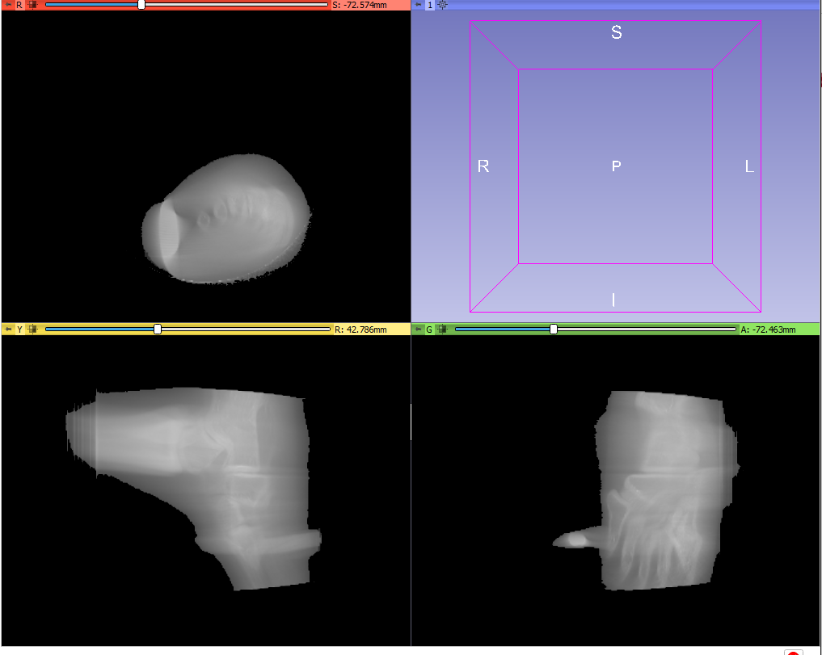
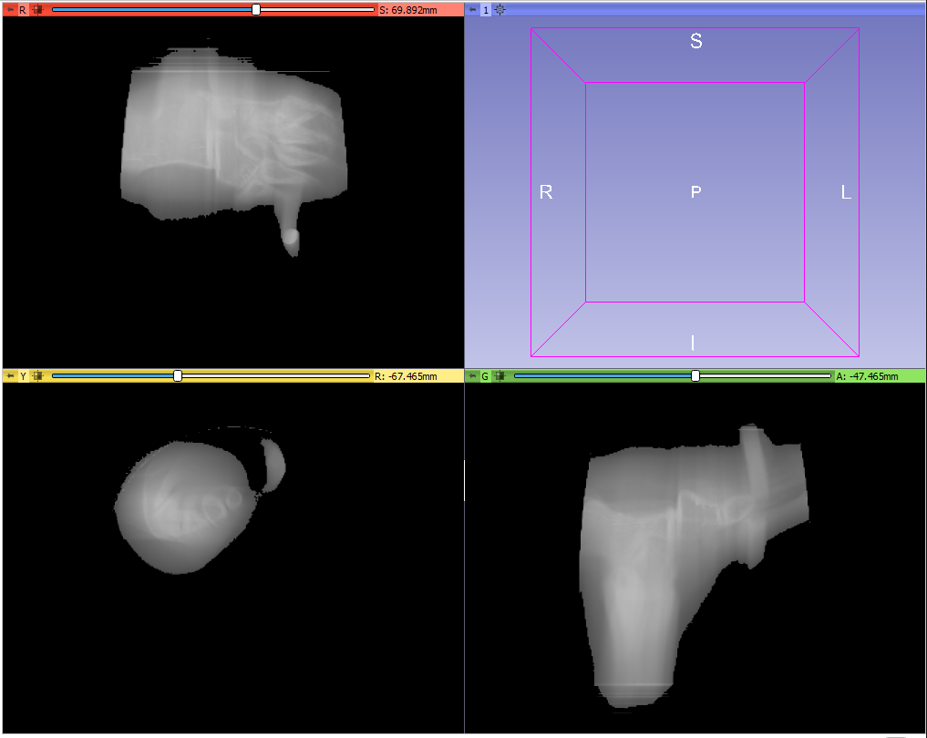
C-ARM Images
TransformMatrix =1 0 0 0 1 0 0 0 1
重建出来的Raw data显示
TransformMatrix =0 0 -1 0 1 0 -1 0 0
TransformMatrix =0 0 -1 -1 0 0 0 1 0

